Slide 1

GCA Award Application
Directions
An easy guide to preparing
your club awards

Slide 2
APPLICATION FOR GCA AWARD (SAMPLE- DUE NOV 15, 2025)
STEP 1 Be sure to submit by Nov 15 your award application for each
award number.
Date of Application Date you apply but before Nov 15 | Name of Award Applied for: Arbor Day Send in to Program Chair for your Award by Nov 15 in 3 copies | Award No. 69
Look in Hortensia for Award Name and Number, and you will find the Program Chair name and contact info.

Slide 3
NEW!!! As a new benefit, you may now scan
your award and email it to the Program Chair
assigned to your award number instead of
making 3 color copies. This saves copy costs
and mailing. Scanning will be optional for
this year, but become required for next year.
Most printers have a scanning option, where
you can print one copy then scan to
create a document.
Name the scanned documents in the
following manner:
Alabama, IV, Tuscaloosa, M, 69, Arbor Day
(State, Disrict, Club Name, Size of Club S-M-L, Award #, Name e of Award)
Club Size Categories for GCA
i Small Club 29 members and under
ii Medium Club 30-59 members
Iii Large Club 60-99 members
Iv Extra Large Club 100 members and over

Slide 4
[X ] Garden Club [ ] Group of Clubs [ ] Individual [ ] Council or Federation | Name of Your Club
Name of Applicant (type exactly as name should appear on award) | Name of Your Club
Name of Person Submitting Award Application: Name | Title Club Awards Chairman or Club President Submitting
Address – Of person submitting | City City in which submitter lives | Zip zip code
E-mail Address submitter email address | No. of Members in Club: 22 | GCA District IV

Slide 5
STEP 2
Fill in this section of award form, following instructions.
New project? Yes _X___ No __ Beginning date: Jan 1, 2024
Completion date Nov 2025
Is this a new or ongoing project. Dates are important.

Slide 6
IMPORTANT - TOTAL NO MORE THAN
3 PAGES overall (including header)

Slide 7
STEP 3
Type application in 12 point font (no handwriting)
2.Goal: Brief summary and objectives of project:
List in a few lines your goal for the project.
(Sample) Planted a tree at a Historic Home in our community.
Help students plant a tree at their school yard.
Since the state theme is to plant a Maple or Ginkgo Tree,
“Add Color to Alabama in the Fall”, we chose to plant a Maple
which provided color and shade at the local Elementary School.

Slide 8
STEP 4
Summary:
Write a paragraph or two of what you did,
where you started, what the finished product was,
who was involved in as much detail as you can.

Slide 9
STEP 5
3. Involvement of club members, other
organizations, etc.: List who participated, more
points assigned when public, children, non club
members, etc are involved.

Slide 10
STEP 6
4. Project expenses and means of funding:
What money did you spend,
where did it come from.

Slide 11
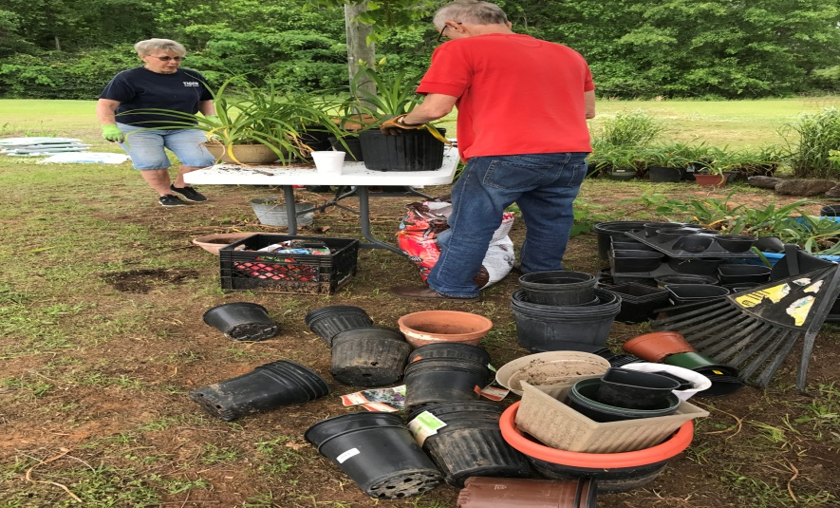
STEP 7
5.Continuing involvement, follow-up, maintenance:
(sample)The Garden Club will do what to follow-up
and maintain or improve project.

Slide 12
STEP 8
6. Photos below: Add as many photos with descriptions (very important) of what you did. A picture is worth a 1,000 words. Avoid staged photos of your club members only. Action photos are rated better.

Slide 13
DO NOT GO OVER 3 PAGES –
SEND IN 3 COPIES
TO PROGRAM CHAIR (or Scan and send)
Type your application in 12 point font
to be eligible for first place

Slide 14
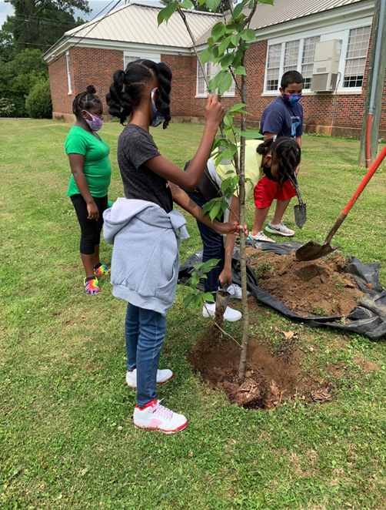
Be sure to label each picture with description of activity. Pictures can be any size, and as many as you want as long as the overall application does not exceed 3 pages.

Slide 15
HELPFUL NOTE: Board Member Program
Chairs we ask that you send an email
to the Applicant once you receive
their award information
so everyone knows they have arrived safely
If you feel the application can be improved for
Deep South or National Award consideration,
you can ask the applicant to make modifications to their submission as long
as the amended application is received by Nov 15.

Slide 16
Program chairs (Board Members) are to evaluate
applications and send the first and second place
winners to the State Awards Chairs
(Frances Butler and Carla Hewitt) by no later than
Dec 1. Also send a list of the names of any third
place or honorable mentions (any number)
you feel should get awards.
GCA Awards Chairs will send first place winners
that meet award categories on to Deep South
and National by Jan 1.

Slide 17
Hint: You can use the National Instructions to help you make your award photos and applications even more professional.
Use the evaluation guide to help you include wording that enhances your application.

Slide 18
Good Luck Earning your Awards
You might find that your project will come under more than one award category. Go ahead and modify your application to fit criteria of each award category and submit.

