Slide 1
DSGC Convention, hosted by Florida Federation of Garden Clubs, Inc., March 2026 --options

Slide 3
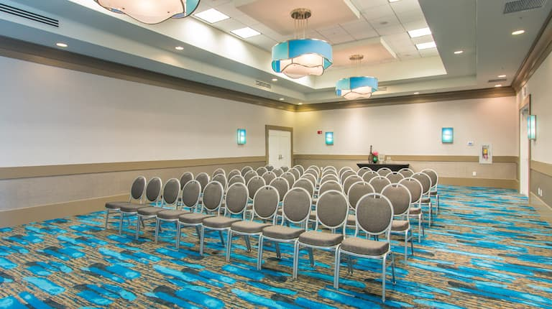
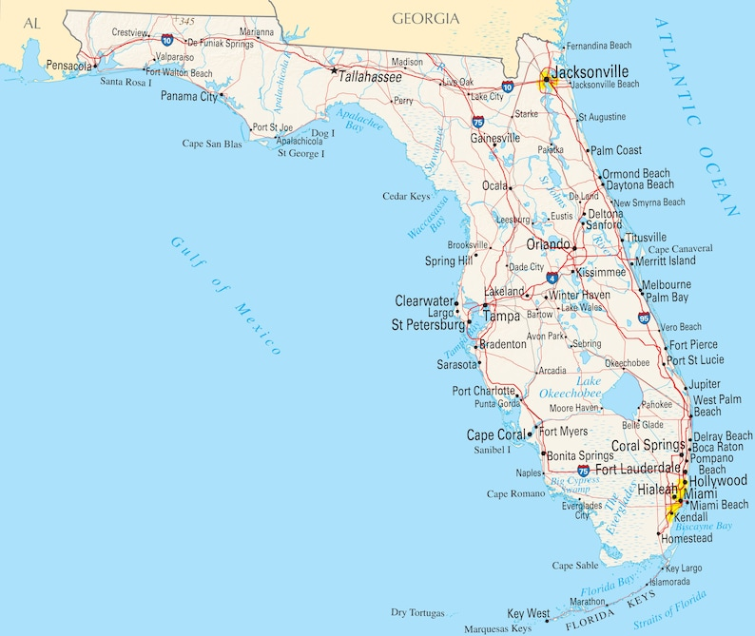
Hilton, Pensacola Beach, FL
$239 per night
9-12 March 2026
AV and F&B minimums
12 Via De Luna Dr, Pensacola Beach, FL
Estimated budget $85K

Slide 4
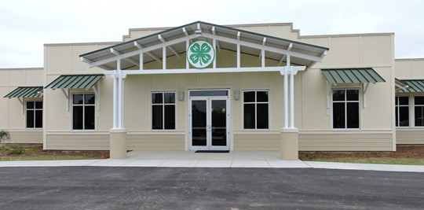
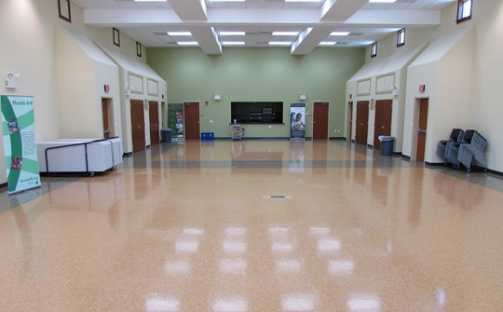
Escambia County 4-H Conference Center
April 29, 2015
23-27 March 2026
3730 Stefani Rd, Cantonment, FL
Free AV and rental, All meals catered in
Hotel on your own (near exit 8, I-10, Pine Forest Rd)
Overall budget $10K

Slide 5
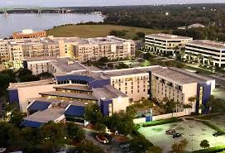
Jacksonville’s Southbank Marriott Hotel
1515 Prudential Drive, Jacksonville, FL
$148 per night
AV and F&B minimums
Estimated budget $88K

Slide 6
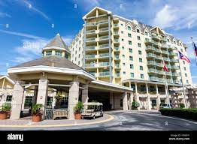
St. Augustine’s World Golf Village Renaissance
$144 per night (a Marriott property)
500 S Legacy Trail, St. Augustine, FL
AV and $F&B minimums
Estimated budget $80K

Slide 7
Orlando’s Rosen International Hotel
3-6 March, 2026
Room rate $179 per night
AV and F&B minimums
7600 International Drive, Orlando
Estimated budget $82K

Slide 8
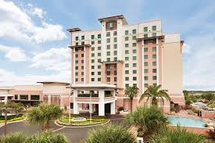
Kissimmee’s Embassy Suites Hotel
Free breakfast and free cocktail in the afternoon
4955 Kyngs Heath Rd, Kissimmee, FL (off US 192)
$150 per night (a Hilton property)
AV and F&B minimums
Estimated budget $88K

Slide 9
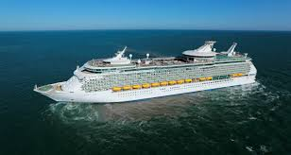
Royal Caribbean Cruise Line
March 16-21, a 5-night cruise aboard “Explorer of the Seas” out of Port Canaveral, FL
Visits to Labadee, Haiti and Coco Cay, Bahamas
Room, meals, entertainment included= $533 (plus tax) per person/double occupancy (plus $18.50 per day gratuity and parking)
Free cocktail party for attendees
Free conference rooms and free AV for Tuesday and Thursday
Incentive to states booking 16 rooms (32 people)=1 free berth
Estimated budget $500 but…. Possible bonus!

Slide 10
Bottom Line Cost to You
City | Hotel | dates | room price + reg. $255 | A V | F&B | Notes
 |  |  | (3 nights?)
Pensacola Beach | Hilton (Kim) | 9-12 March | $239 and up ($717) | contracted out | 20K | spring break room pricing in March, comp parking
Pensacola 4-H conference center | on your own, 4 to recommend (Brian Estevez) | 23-27 March | up to individual | $0 | $0 | 4 local hotels recommended at I-10 exit at Pine Forest Rd.
Orlando | Rosen International (Marissa) | 3-6 March | $179 night ($537) | 20% off | $40K | 1:40 comp room, $17 a day parking, 20% meeting room internet
Orlando-Kissimmee | Embassy Suites |  |  | $25K | 35K | free breakfast, free afternoon happy hour
Jacksonville | Southbank by Marriott (Antonia) |  | $148 night (444) | $25K | $40K
St Augustine | World Golf Village Renaissance |  | $144 night ($432) |  |  | Request M01737217053521, area for sale?
Port Canaveral | Cruise Line (Shelley at Funseas.com) | March 16-21 | $533 +tax for 5 nights | AV and confernce room free | $0 | Labadee, Haiti and Coco Cay/2 days at sea. Cocktail party 1st day.
 |  |  | incentive for 16 rooms |  |  | Cruise is no cash. Requires $18.50/day for service and $17/day for cruise terminal parking. Meals, entertainment included in cost.

Slide 11
Your Choice—Vote!
Questions?
Discussion?
Decision!

