Slide 1
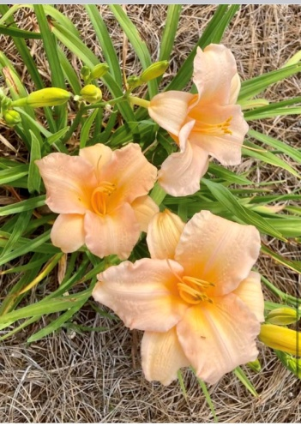
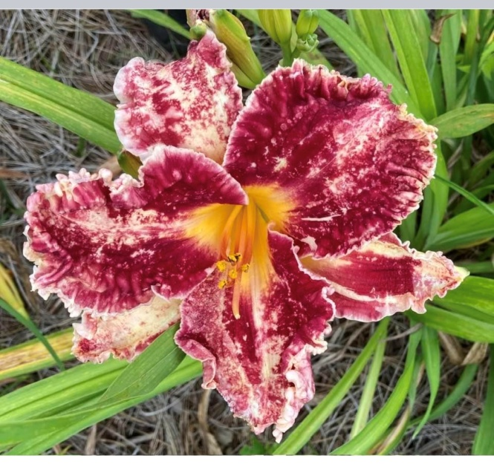
GCA AWARDS 2023
THANKS TO ALL WHO SUBMITTED AWARDS, YOU SHOULD BE PROUD OF YOURSELF FOR ALL YOUR HARD WORK

Slide 2
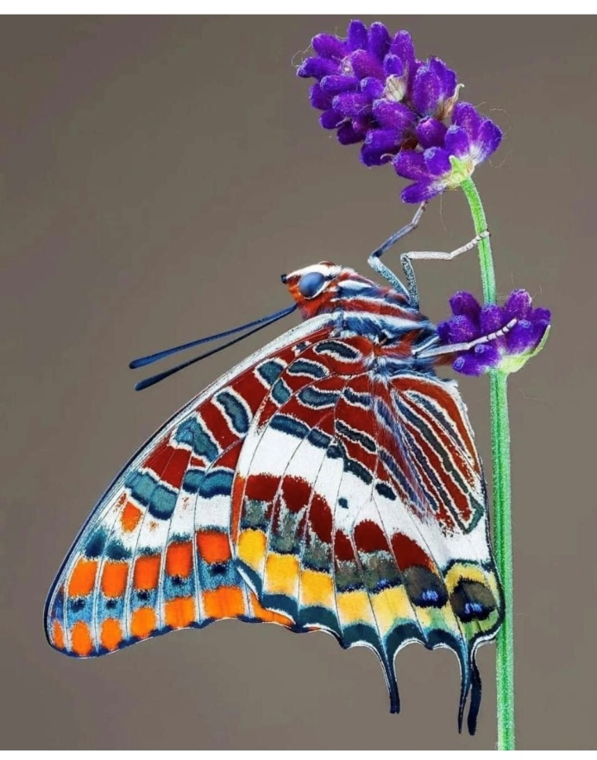
STATE AWARDS FOR MEDIA
Social Media
Web, Hortensia, and Facebook
Stephanie Butler
Joey Skaff
Kim Edgerton
Public Relations
Web, Hortensia, and Facebook
Stephanie Butler
Joey Skaff
Kim Edgerton

Slide 3
DISTRICT I WINNERS (8)
Blossomwood 1st School Grounds
Blossomwood 1st Yearbook
Madison 1st Therapy Gardens
Muscle Shoals 1st Historic Decore
Red Bay 2nd Birds
Red Bay 2nd Roadside Beauty
Town & Country 1st Jr Garden Club
Town & Country HM Yearbook

Slide 4
DISTRICT II WINNERS (16)
Amaryllis 1st Christmas Lights
Amaryllis 1st Yearbook (-20)
Amaryllis 2rd Community Beaut
Colony 2nd Therapy Gardens
Colony 1st Floral Design
Colony HM Yearbook (20-29)
Colony 1st Christmas Lights
Colony 1st Horticulture Sch
Colony 1st Community Action
Fort Payne 1st Landscape Design
Greenlawn 1st Native Plants Proj
Mentone 1st Publicity Press
Rainsville 2nd Community Service
Rainsville 1st Edible Gardening
Rainsville 1st Video/CD/Flash Dr
Rainsville 1st Yearbook (20-29)

Slide 5
DISTRICT III WINNERS (25)
Blue Star 2nd Yearbook (-20)
Blue Star 2nd Historic Preserve
Edgewood 1st Birds
Edgewood 1st Horticulture
Edgewood 1st Recycling
Edgewood 2nd Adopt A Park
Edgewood 2nd Therapy Gardens
Edgewood 3rd Yearbook (30-44)
Fed Garden Cl 1st Petite Small Show
Fed Garden Cl 1st Council Standard
Fed Garden Cl 2nd Yearbook Group
Fed Garden Cl 3rd Flower Show Sch

Slide 6
DISTRICT III WINNERS Continued
Fed GC of Dist 1st Patriotic Small Std
Fed GC of Dist 1st Council Std
Fed GC of Dist 1st Petite Small Show
Fed GC of Dist 2nd Yearbook (Group)
Fed GC of Dist 3rd Flower Show Sched
Magnolia 1st Recycling
Magnolia 1st Youth Horticulture
Magnolia 2nd Civic Achievement
Magnolia 2nd Horticulture
Magnolia 3rd Community Action
Magnolia HM Yearbook (20-29)
NE Council 2nd Flower Show Sch
NE Council 3rd Yearook (Group)

Slide 7
DISTRICT IV WINNERS (47)
Fayette 1st Litter Control
Fayette 1st Roadside Beauty
Fayette 1st Yard of the Month
Fayette 1st Adopt A Park
Fayette 1st Community Action
Fayette 1st Container Garden
Fayette 1st Therapy Gardens
Fayette 1st Youth Horticulture
Fayette 1st Christmas Lights
Fayette 1st Every Light a Prayer
Fayette 2nd Yearbook (30-44)
Fayette 2nd Butterfly

Slide 8
DISTRICT IV MORE AWARDS
Greensboro 1st Birds
Greensboro 1st Litter Control
Greensboro 1st Organic Garden
Greensboro 1st Comm Beauty
Greensboro 1st Community Svc
Greensboro 1st Civic Achieve
Greensboro 1st Special Achieve
Greensboro 1st Horticulture
Greensboro 1st Pres of Historic
Greensboro 1st Décor of Historic
Greensboro 1st Outdoor Class
Greensboro 1st Arbor Day
Greensboro 2nd Polinaators
Greensboro 2nd Comm Action
Greensboro 2nd Edible Garden

Slide 9
DISTRICT IV MORE AWARDS
Tuscaloosa/NP 1st Polinators
Tuscaloosa/NP 1st Comm Beauty
Tuscaloosa/NP 1st Comm Service
Tuscaloosa/NP 1st Adopt A Park
Tuscaloosa/NP 1st Env Education Y
Tuscaloosa/NP 1st Youth Leaders
Tuscaloosa/NP 1st Tree Planting
Tuscaloosa/NP 1st Publicity Press
Tuscaloosa/NP 2nd Recycling
Tuscaloosa/NP 2nd School Ground
Tuscaloosa/NP 2nd Wildflower
Tuscaloosa/NP 2nd Youth Horticul
Tuscaloosa/NP 3rd Special Achieve
Tuscaloosa/NP HM Yearbook (-29)

Slide 10
DISTRICT IV MORE AWARDS
Goldenrod 1st Food Bank
Goldenrod 2nd Special Achiem
Goldenrod 3rd Horticulture
Fayette/Tuscal 1st Comm Action
Ceres/Greensboro
Tuscaloosa/Coker 1st Holiday Dec
Fayette & Tuscaloosa/
Northport 1st Community Act
Ceres & Tusc/NP 1st Community Svc
Ceres & Tusc/NP 1st Public Relation

Slide 11
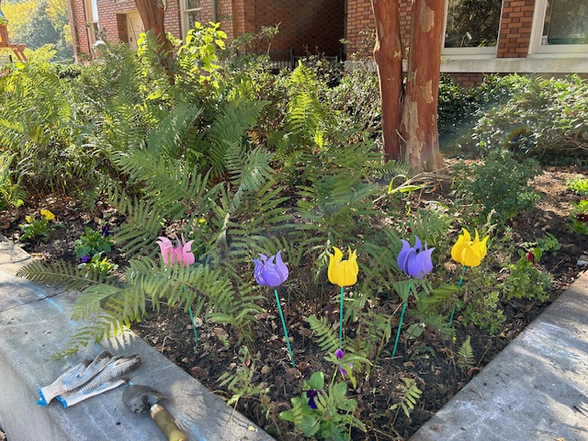
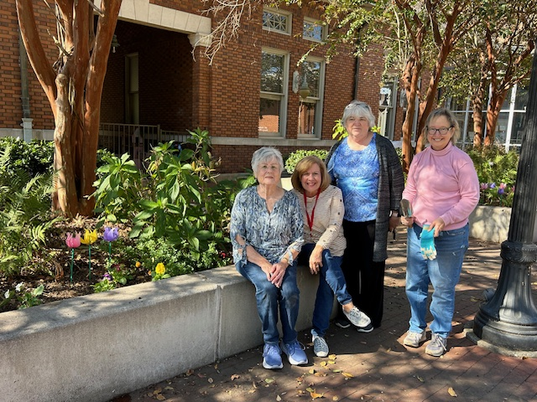
DISTRICT V AWARDS (3)
Opelika 2nd Community Svc
Opelika 3rd School Ground
Sylacauga 3rd Community Svc

Slide 12
DISTRICT VI AWARDS (14)
Georgiana 1st Smokey Bear
Georgiana HM Publicity Press
Montgomery F 1st Publications
Montgomery F 1st Yearbook (group)
Montgomery F 1st Flower Show Sched
Montgomery F 1st Near ClubStandard
Montgomery F 1st Flower Show Sch
Montgomery F 2nd Publicity Press
NE Federation 1st Publicity Press
Yaupon 1st Church Landscape
Yaupon 2nd Community Beaut
Yaupon 2nd Food Bank Don
Yaupon 2nd Comm Landscape
Yaupon 2nd Yearbook (-30)

Slide 13
DISTRICT VII AWARDS (5)
Flower Lovers 1st Community Beauty
Camilia GC 1st Every Light Prayer
Camilia GC 2nd Community Beauty
Flower Lovers 2nd Arbor Day
Chunnenuggee HM Jr Yearbook

Slide 14
DISTRICT VIII AWARDS (11)
Fairhope 1st Butterfly
Fairhope 1st Special Achieve
Fairhope 1st Public Relations
Gulf Shores 1st Dec of Historic Bldg
Gulf Shores 1st Social Media
Gulf Shores 1st Yearbook (70-99)
Gulf Shores HM Smokey Bear
Lydia White
Gulf Shores HM Smokey Bear
William Voegle
Orange Beach 1st Historic Pres
Orange Beach 1st Special Achieve
Sampson 1st Yearbook (-45)

Slide 15
Clubs of Distinction
District III - 5 clubs reported
*Blue Star Garden Club 161
*
District I - 9 clubs reported
*Blossomwood Garden Club 150
Cultura Garden Club 128
*Florence Garden Club 165
Lakeside Garden Club 108
*Red Bay Garden Club 639
Redstone Garden Club 106
Town and Country Garden Club (129)
*Trowelers Garden Club 258
*Willowbrook Garden Club 558
Camellia Garden Club (Birmingham) 200
*Edgewood Garden Club 179
*Garden Dale Garden Club 371
*Magnolia Garden Club (Warrior) 209
District IV - 4 club
Fayette Garden Club 556
Goldenrod Garden Club 100
*Greensboro Garden Club 276
*Tuscaloosa/Northport Garden Club 254
District II - 6 clubs reported
Amaryllis Garden Club 134
*Cherokee Rose Garden Club 374
*Colony Garden Club 224
Greenlawn Garden Club 110
*Rainsville Garden Club 184
*Rhododendron Garden Club 161

Slide 16
District V - 3 clubs reported
*Town and Country Garden Club (Sylacauga)159
*Tulip Garden Club (Opelika) 165
*Wedowee Garden Club 240
District VI - 5 clubs
*Canterbury Bells Garden Club 206
*Down to Earth Garden Club 167
*Georgiana Garden Club 160
*Scattered Seeds Garden Club 264
Southern Charm Garden Club 114
District VII - 7 clubs reported
Camellia Garden Club (Clayton) 105
Camellia Garden Club (Eufaula) 130
*Chunnenuggee Garden Club 228
*Flower Lovers Garden Club 422
*Garden Club By The Lake 250
*Lovely Touch Garden Club 223
*Tulip Garden Club (Phenix City) 271
District VIII - 4 clubs reported
*Fairhope Garden Club 255
*Gulf Shores Garden Club 785 (highest points)
*Magnolia springs Garden Club 264
*Spanish Fort Garden Club 233

Slide 17
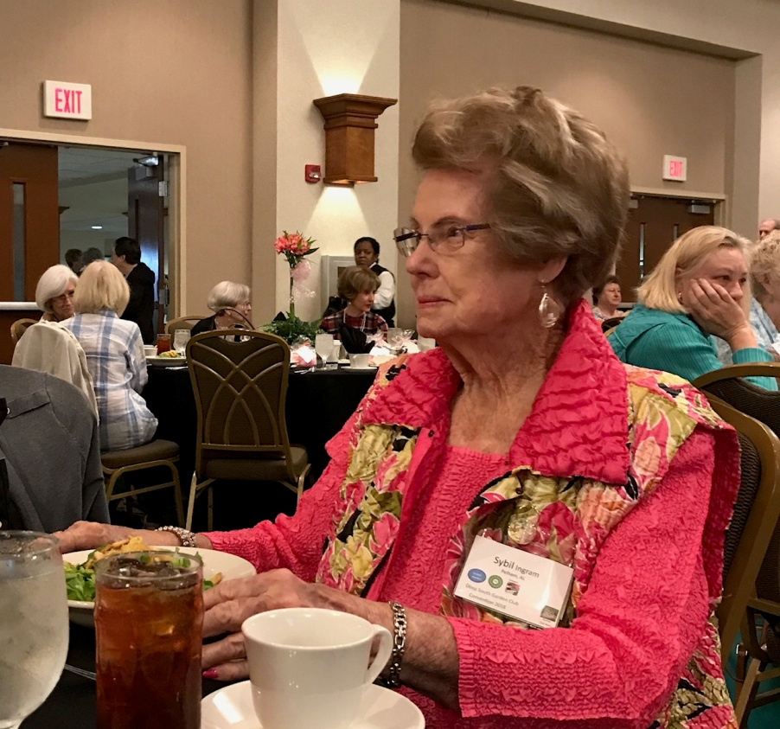
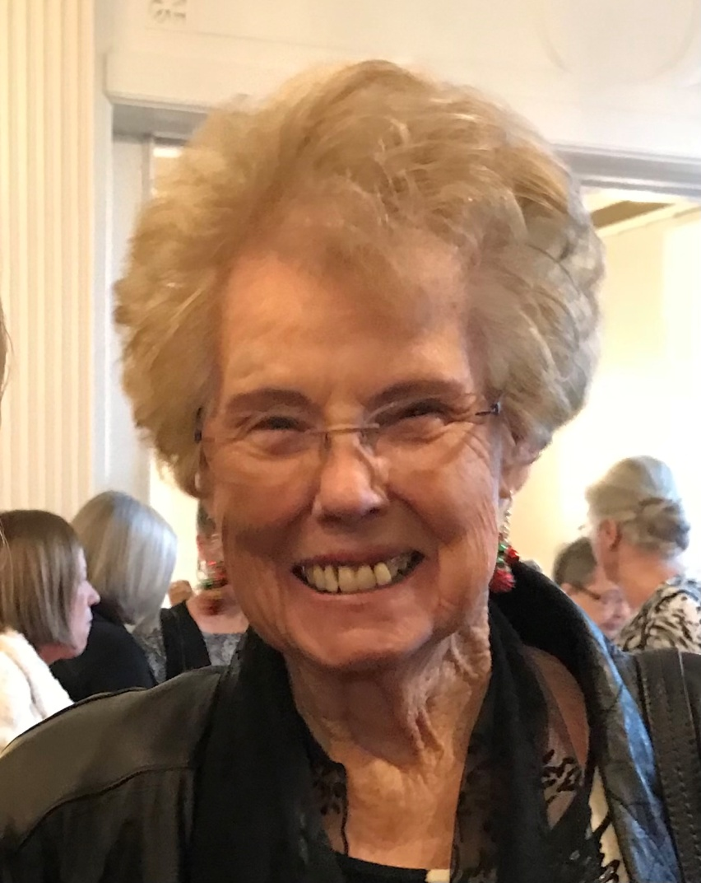
MENTOR OF THE YEAR – SYBIL INGRAM (Our Great Loss)

Slide 18
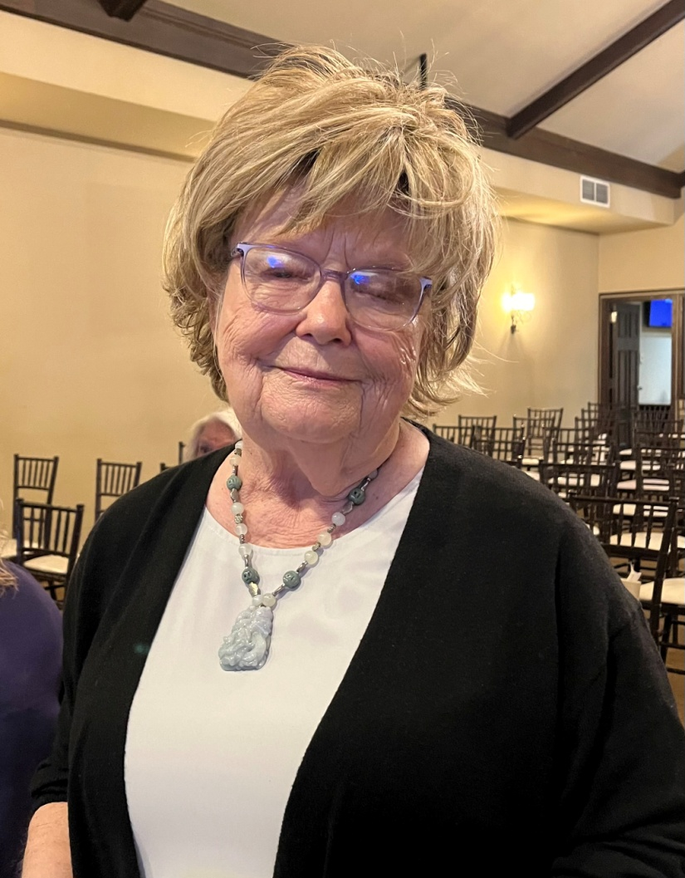
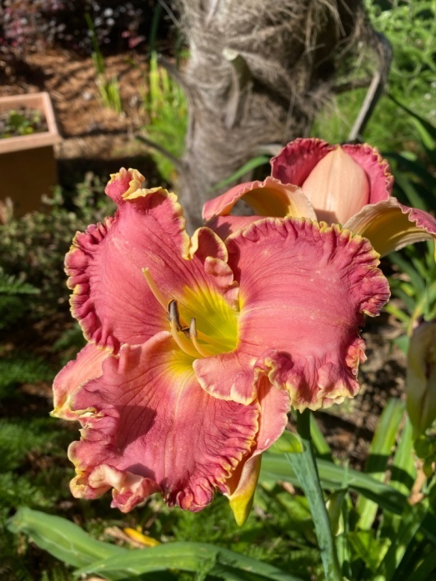
MEMBER OF HONOR – JAN THOMAS

Slide 19
Deep South Awards Given 3/24
Blossomwood 2nd School Grounds Improvement
Greensboro 2nd Historic Preservation
Greensboro 1st Litter Control
Greensboro 1st Birds
Edgewood HM Birds
Greensboro 1st Tree Planting ($25)
Greensboro 2nd Horticulture
Fort Payne 2nd Landscape Design
Fairhope HM Butterfly Conservation

Slide 20
Deep South Awards Given 3/24
Magnolia HM Horticulture
Greensboro 3rd Arbor Day
Flower Lovers 3rd Arbor Day
Northeast Al Fed 1st Publicity Press Book
Rainsville 2nd Yearbook
Northend Council 3rd Yearbook
(15 Awards)

Slide 21
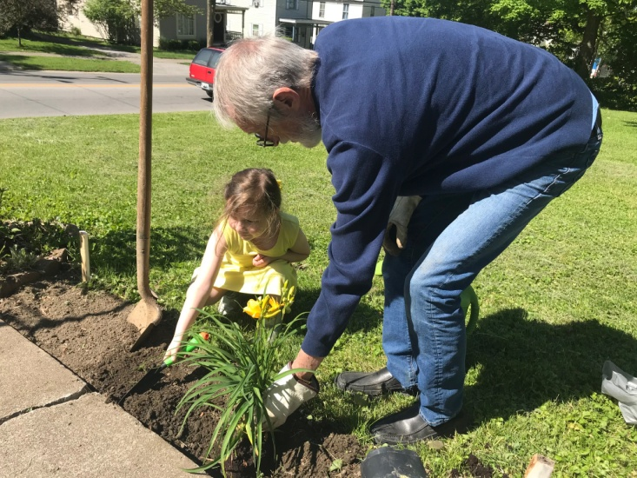
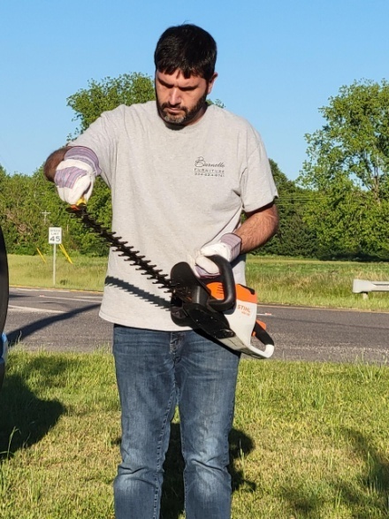
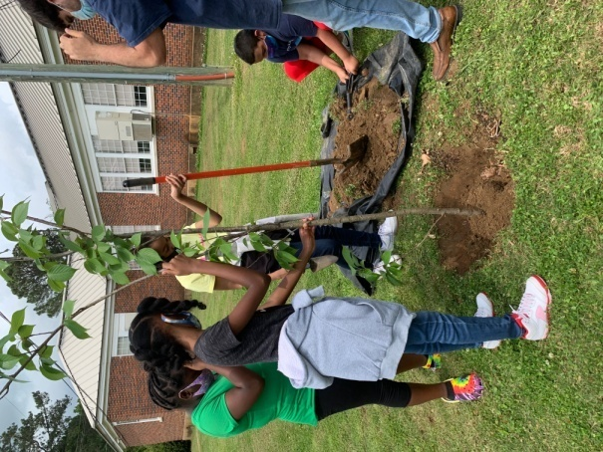
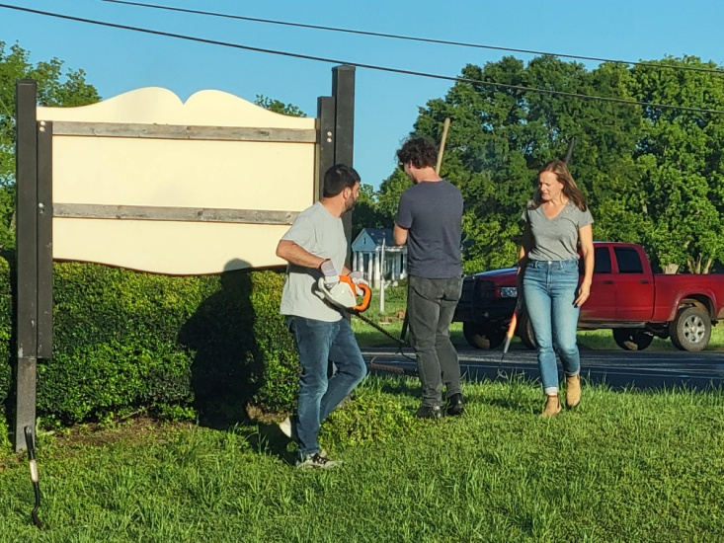
PLEASE TAKE THE TIME TO WRITE UP AWARDS TO GIVE YOURSELF CREDIT FOR ALL YOU ARE DOING.

